Slide 1

Vel Tech Rangarajan Dr. Sagunthala R&D Institute of Science and Technology
School of Computing
Department of Computer Science and Engineering
10211CS224 / FULL STACK APPLICATION DEVELOPMENT (JAVA)
PROJECT REVIEW : MILESTONE PROJECT – 1
Date: 23-03-2026
AUTOMATED QUIZ ENGINE WITH PDF CERTIFICATION GENERATION
SDG: SDG 4 – Quality Education
Presented By:
Innamuri Sai Ram – VTU24835 – Reg.No:23UECS0741
Courses Handling Faculty:
Dr. Hafizur Rahman- B.E., M.Tech., Ph.D.

Slide 2
INTRODUCTION
1
In today’s digital learning environment, online assessments play a key role in evaluating knowledge.
Traditional quiz systems often lack automation and certification features.
This project aims to provide an automated quiz platform with instant evaluation.
It generates certificates in PDF format after successful completion.
The system reduces manual effort and ensures accuracy.
It is useful for educational institutions and online learning platforms.
Provides real-time results and feedback to users.
Built as a dynamic web application using modern technologies.
2
3
4
5
6
7
8
9

Slide 3
PROBLEM STATEMENT
1
Existing quiz systems require manual evaluation and certification.
Lack of automated certificate generation increases workload.
Many platforms do not provide real-time results and feedback.
Managing user data and quiz records manually is inefficient and time-consuming.
There is a lack of centralized systems to store and track quiz performance.
Security issues arise due to improper user authentication and session handling.
Traditional systems are not scalable for large numbers of users.
2
3
4
5
6
7
8
9

Slide 4
OBJECTIVE(S)
1
To design and develop an automated quiz system with real-time evaluation using PHP and MySQL.
To implement PDF certificate generation and improve efficiency in quiz management and result processing.
To ensure secure user authentication and maintain data integrity using session management.
To provide a user-friendly interface for easy quiz access and performance tracking.
2
3
4
5
6
7
8
9

Slide 5
PROPOSED SYSTEM
Web-based automated quiz platform accessible through any web browser without installation.
Users can register, login securely, and attempt quizzes anytime from anywhere.
Questions are stored in MySQL database and fetched dynamically based on selected quiz.
System evaluates answers instantly and provides real-time score calculation.
Generates PDF certificates automatically for users who meet the qualification criteria.
Admin panel allows managing questions, users, quiz categories, and results efficiently.
Secure session management using PHP ensures user authentication and data protection.
Improves efficiency, accuracy, scalability, and provides a user-friendly experience.
1
2
3
4
5
6
7
8
9

Slide 6
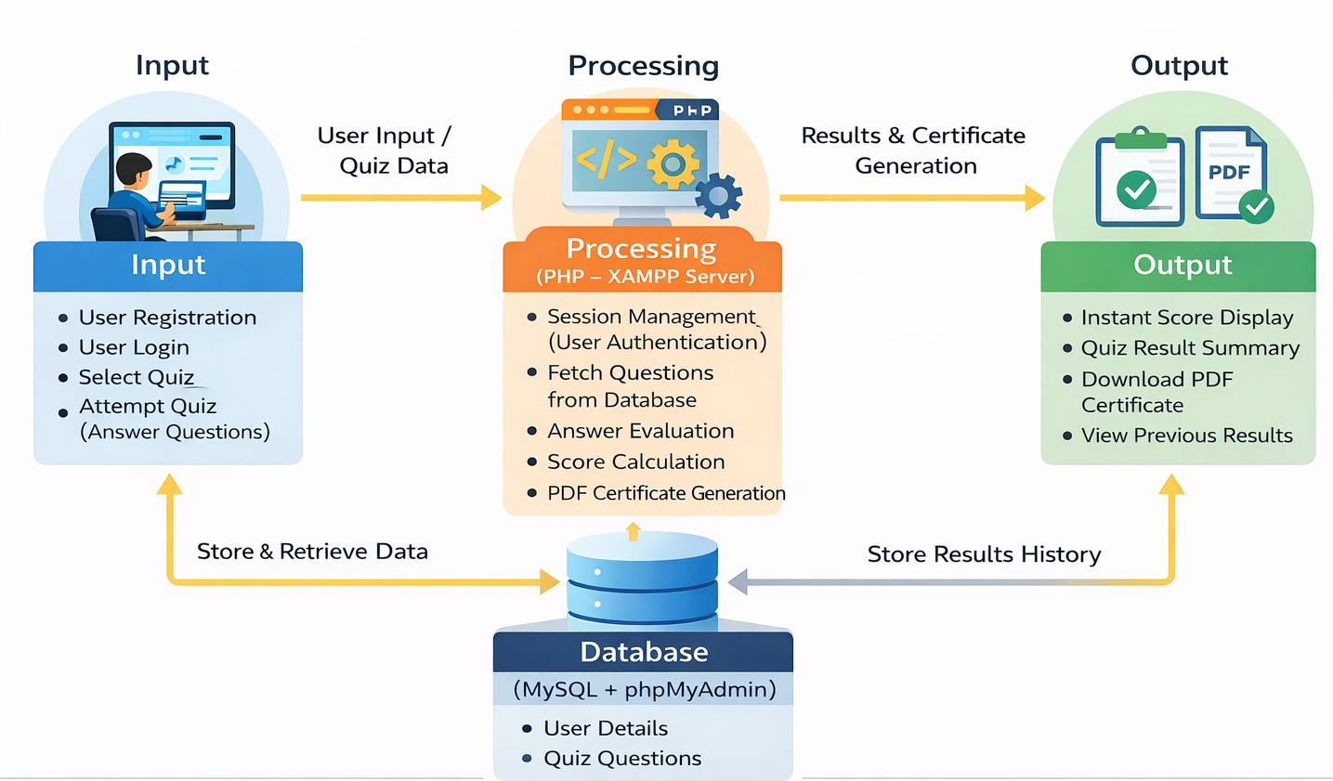
PROPOSED SYSTEM ARCHITECTURE
1
2
3
4
5
6
7
8
9

Slide 7
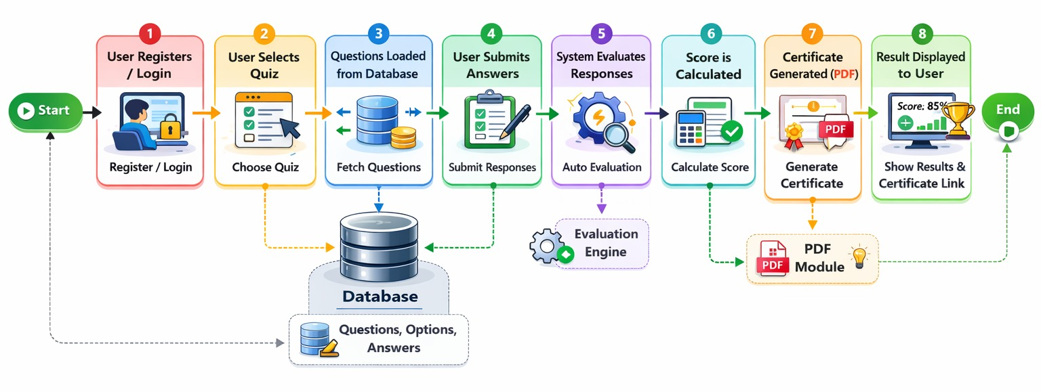
WORKFLOW
1
2
3
4
5
6
7
8
9

Slide 8
TECHNOLOGIES USED
Frontend:
HTML5
CSS3
Backend:
PHP (Core PHP)
Session Management
MySQL(Database Connectivity)
Database:
MySQL
phpMyAdmin
Tools:
XAMPP (Apache + MySQL Server)
Notepad
Web Browser (Chrome)
Hardware / Software Requirements:
System: Windows 10
RAM: Minimum 4GB
Software: XAMPP Server
1
2
3
4
5
6
7
8
9

Slide 9
MODULE DESCRIPTION
Module 1: User Management
Handles user registration, login, and authentication using secure session management.
Ensures only authorized users can access and attempt quizzes.
Module 2: Quiz Management
Manages quiz selection and dynamically loads questions from the database.
Controls quiz flow including start, navigation, and submission of answers.
Module 3: Evaluation System
Evaluates user answers instantly and calculates scores in real-time.
Stores responses and results in the database for future reference.
Module 4: Certificate Generation
Generates PDF certificates automatically for qualified users.
Allows users to download certificates and view past results.
1
2
3
4
5
6
7
8
9

Slide 10
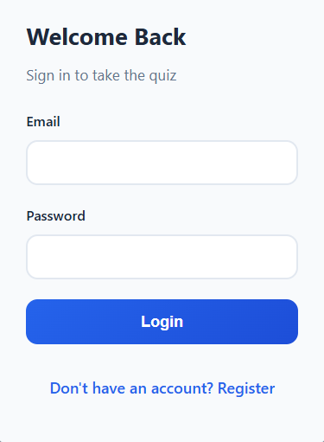
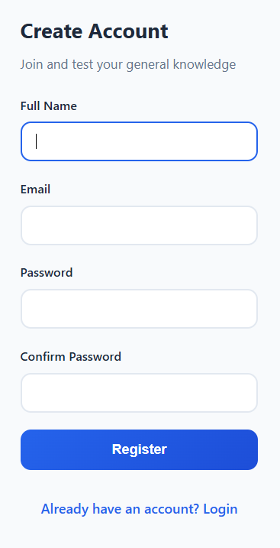
IMPLEMENTATION SCREENSHOTS
1
Login Page:
Login page of the quiz system where users enter email and password to access quizzes.
Provides a secure and user-friendly interface with option for new users to register.
2
3
4
5
6
Register Page:
Registration page where new users can create an account by entering personal details like name, email, and password.
Ensures secure user signup with password confirmation and provides option to login for existing users.
7
8
9

Slide 11
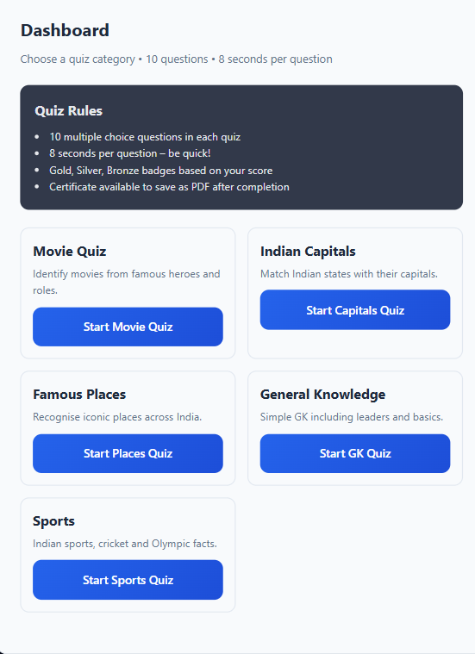
IMPLEMENTATION SCREENSHOTS
Dashboard Page:
Dashboard page displaying quiz categories, rules, and options for users to select and start different quizzes.
Provides an interactive interface with multiple quiz topics and shows important instructions before attempting the quiz.
Displays user information and allows easy navigation with options like logout and dashboard access.
1
2
3
4
5
6
7
8(A)
9

Slide 12
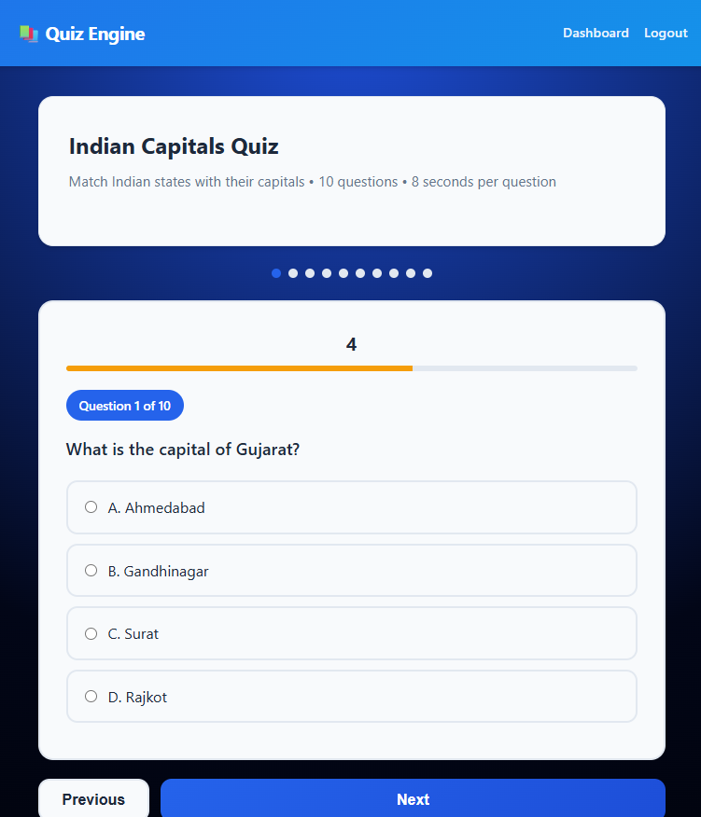
IMPLEMENTATION SCREENSHOTS
1
Quiz Page:
Quiz page displaying questions with multiple-choice options, along with a timer and progress indicator.
Allows users to navigate between questions and submit answers for evaluation.
Provides real-time progress tracking and smooth navigation using Next and Previous buttons.
2
3
4
5
6
7
8(B)
9

Slide 13
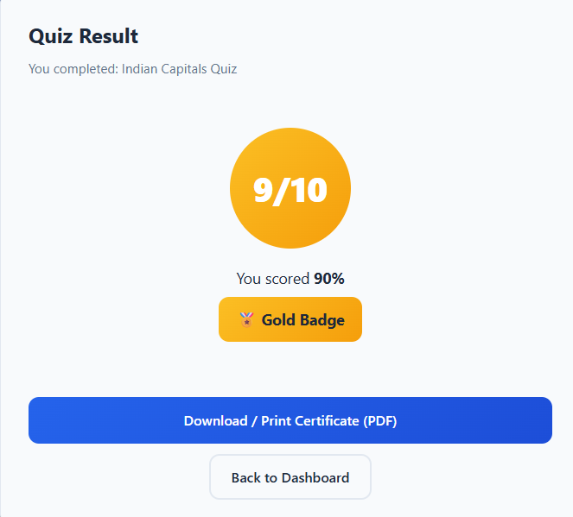
IMPLEMENTATION SCREENSHOTS
1
Result Page:
Result page displaying the user’s score, percentage, and performance badge based on quiz results.
Provides option to download or print the PDF certificate and navigate back to dashboard.
Displays quiz completion summary with total questions, correct answers, and overall performance.
2
3
4
5
6
7
8(C)
9

Slide 14
ADVANTAGES & LIMITATIONS
Advantages:
Fully automated system with minimal human intervention.
Instant result generation with real-time evaluation.
Automatic PDF certificate generation for successful users.
Reduces manual work and saves time for administrators.
Limitations:
Requires internet connection or local server (XAMPP) setup.
Limited to predefined questions.
Basic user interface, can be enhanced for better experience.
No advanced analytics or performance tracking features.
1
2
3
4
5
6
7
8
9

Slide 15
Thank you

